Slide 1
Math. for CS
Ch 10-
Directed graphs & Partial Orders
Prof. Shunxiang Zhang
Anhui University of Science & Technology
Computer Science and Engineering
Mobile Phone：189-6377-7827
Email：sxzh666@gmail.com;sxzhang@aust.edu.cn

Slide 2
Topics covered/Contents
10.1 Vertex Degrees
10.2 Walks and Paths
10.3 Adjacency Matrices
10.4 Walk Relations
10.5 Directed Acyclic Graphs & Scheduling
10.6 Partial Orders

Slide 3
Topics covered/Contents
10.7 Representing Partial Orders by Set Containment
10.8 Linear Orders
10.9 Product Orders
10.10 Equivalence Relations
10.11 Summary of Relational Properties

Slide 4
Ch 10- Directed graphs & Partial Orders
Directed graphs, called digraphs for short, provide a handy way to represent how things are connected together and how to get from one thing to another by following those connections. They are usually pictured as a bunch of dots or circles with arrows between some of the dots, as in Figure 10.1. The dots are called nodes or vertices and the lines are called directed edges or arrows; the digraph in Figure 10.1 has 4 nodes and 6 directed edges.
Digraphs appear everywhere in computer science. For example, the digraph in Figure 10.2 represents a communication net, a topic we’ll explore in depth in Chapter 11. Figure 10.2 has three “in” nodes (pictured as little squares) representing locations where packets may arrive at the net, the three “out” nodes representing destination locations for packets, and the remaining six nodes (pictured with little circles) represent switches. The 16 edges indicate paths that packets can take through the router.

Slide 5
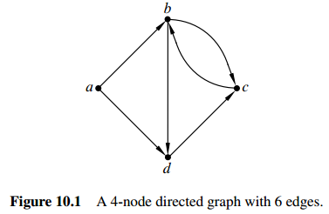
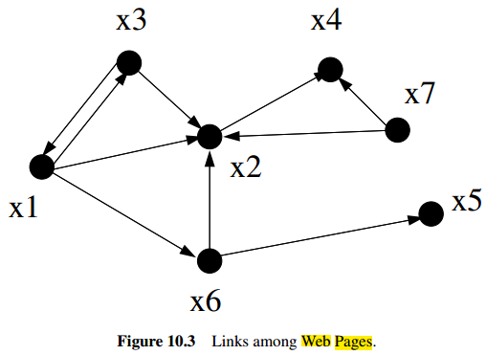
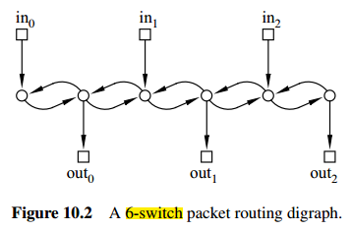
Ch 10- Directed graphs & Partial Orders

Slide 6
Ch 10- Directed graphs & Partial Orders
Another place digraphs emerge in computer science is in the hyperlink structure of the World Wide Web. Letting the vertices x1 ; : : : ; xn correspond to web pages, and using arrows to indicate when one page has a hyperlink to another, results in a digraph like the one in Figure 10.3—although the graph of the real World Wide Web would have n be a number in the billions and probably even the trillions. At first glance, this graph wouldn’t seem to be very interesting. But in 1995, two students at Stanford, Larry Page and Sergey Brin, ultimately became multibillionaires from the realization of how useful the structure of this graph could be in building a search engine. So pay attention to graph theory, and who knows what might happen!

Slide 7
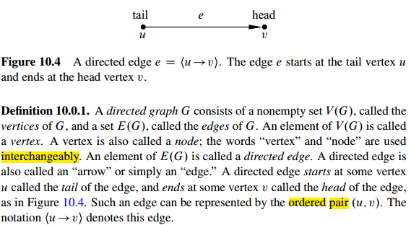
Ch 10- Directed graphs & Partial Orders

Slide 8
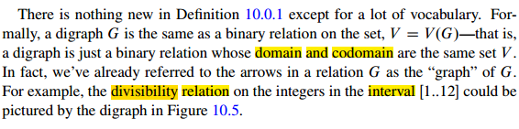
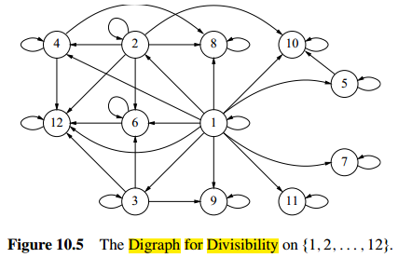
Ch 10- Directed graphs & Partial Orders

Slide 9
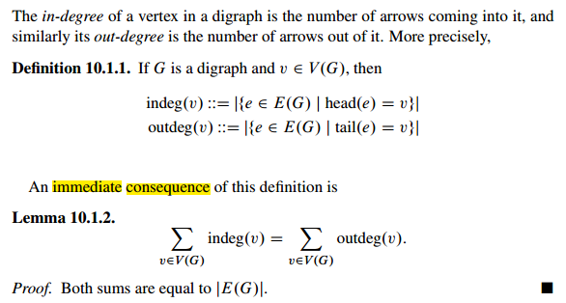
10.1 Vertex Degrees

Slide 10
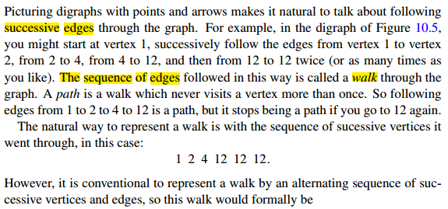
10.2 Walks and Paths

Slide 11
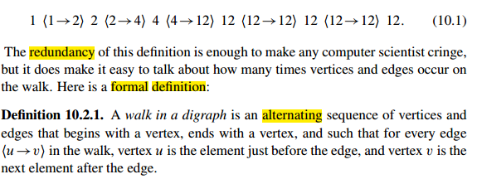
10.2 Walks and Paths

Slide 12
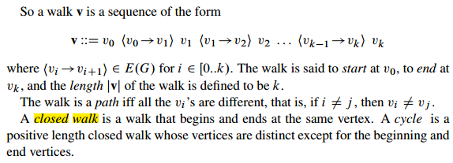
10.2 Walks and Paths

Slide 13
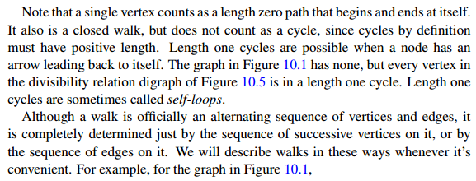
10.2 Walks and Paths

Slide 14
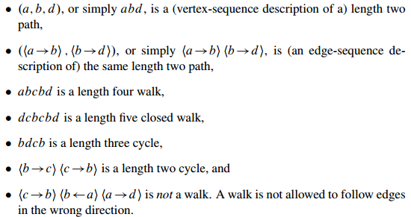
10.2 Walks and Paths

Slide 15
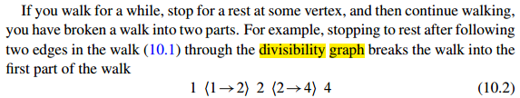
10.2 Walks and Paths

Slide 16
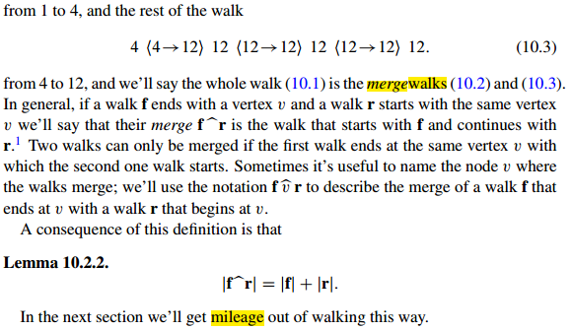
10.2 Walks and Paths

Slide 17
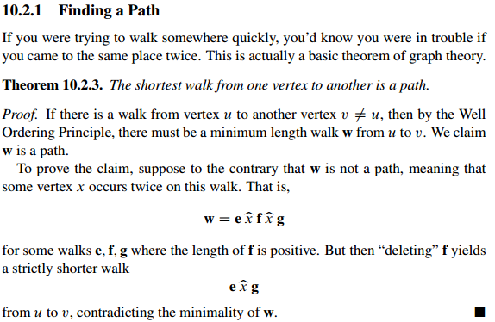
10.2 Walks and Paths

Slide 18
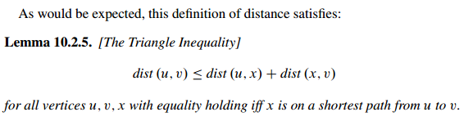
10.2 Walks and Paths

Slide 19
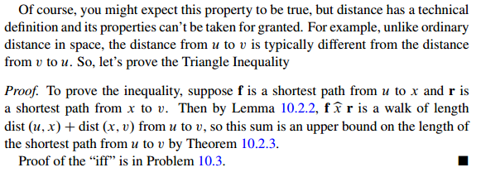
10.2 Walks and Paths

Slide 20
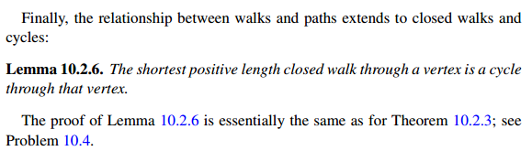
10.2 Walks and Paths

Slide 21
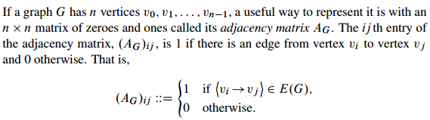
10.3 Adjacency Matrices

Slide 22
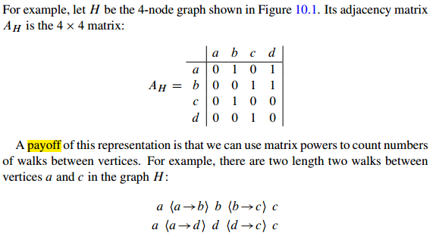
10.3 Adjacency Matrices

Slide 23
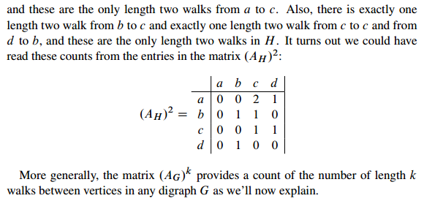
10.3 Adjacency Matrices

Slide 24
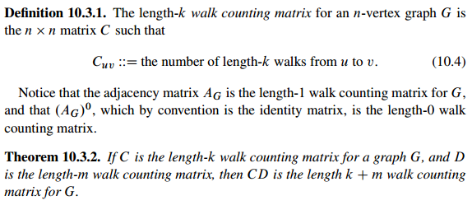
10.3 Adjacency Matrices

Slide 25
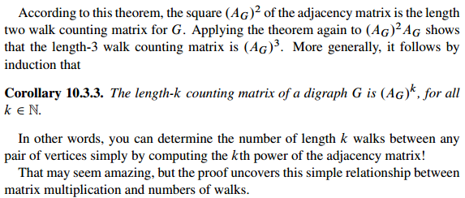
10.3 Adjacency Matrices

Slide 26
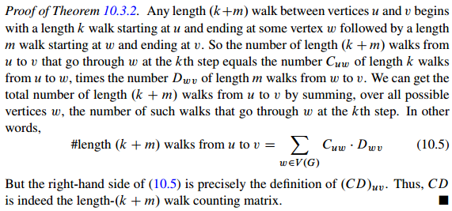
10.3 Adjacency Matrices

Slide 27
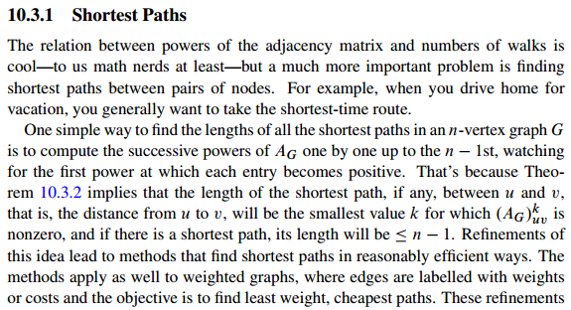
10.3 Adjacency Matrices

Slide 28
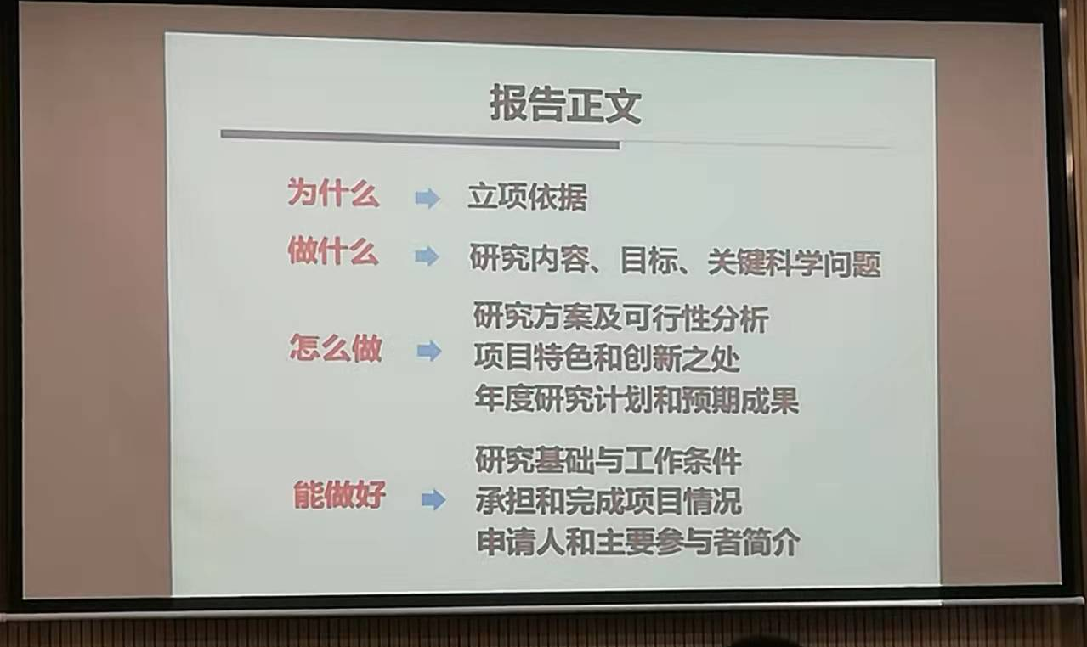
从项目申请看学生开题

Slide 29
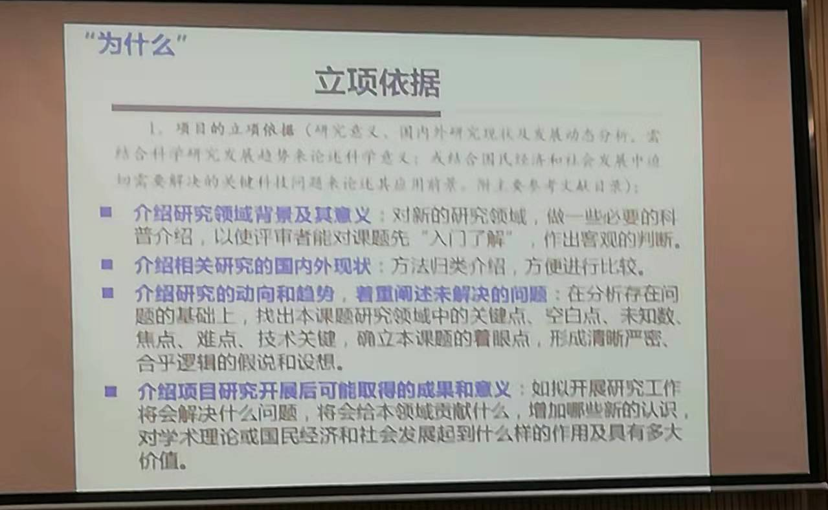
从项目申请看学生开题

Slide 30
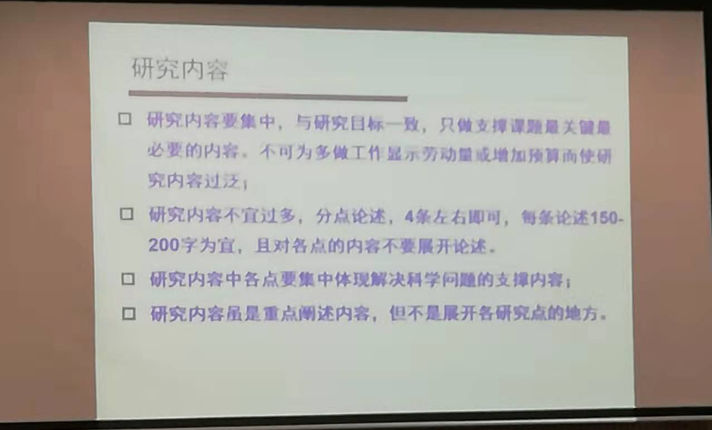
从项目申请看学生开题

Slide 31
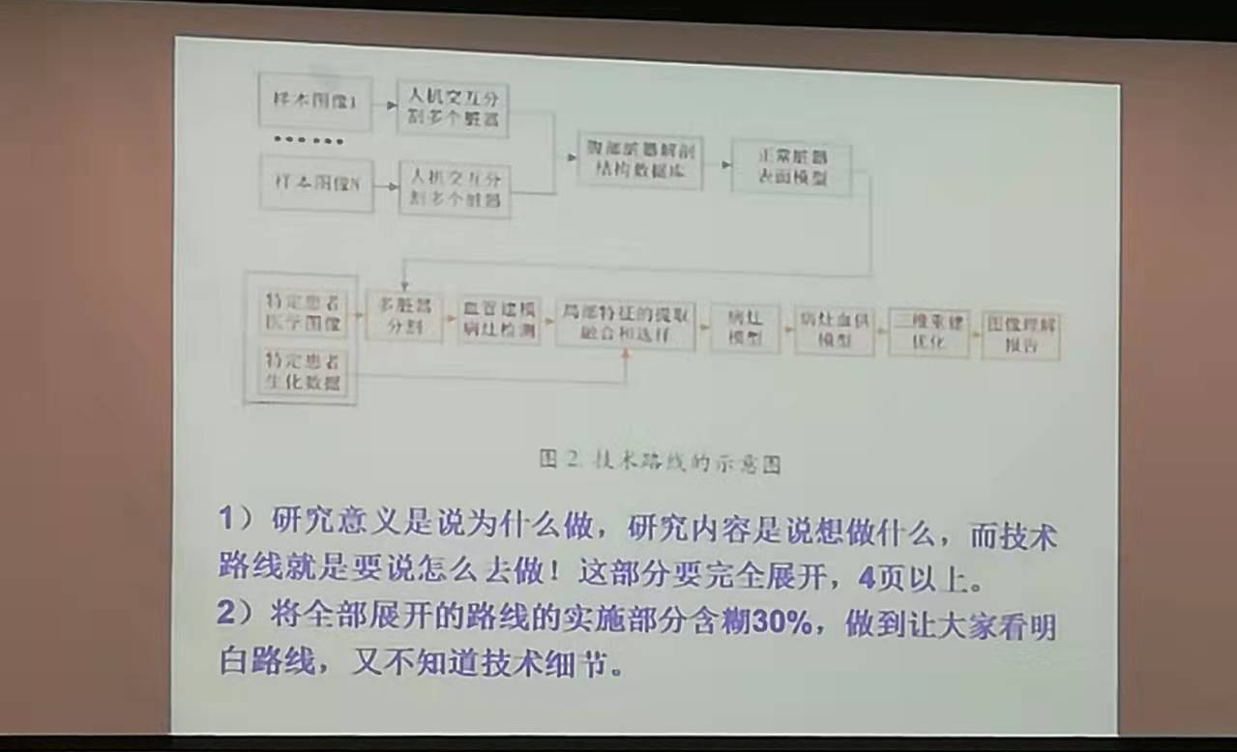
从项目申请看学生开题

Slide 32
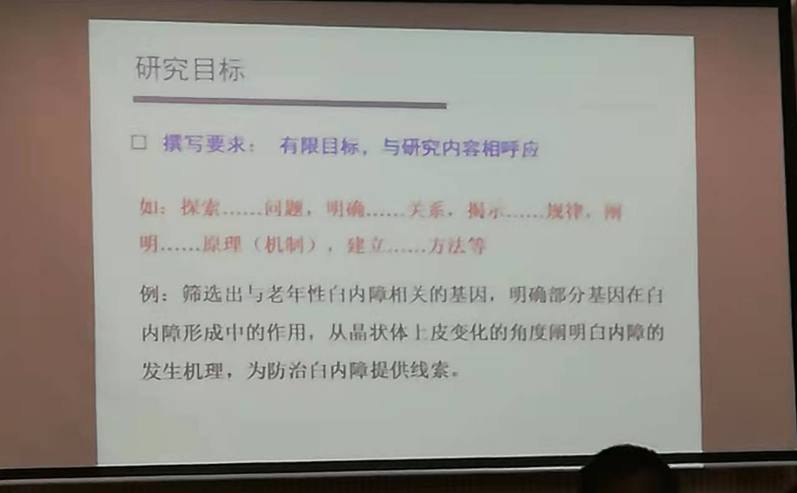
从项目申请看学生开题

Slide 33
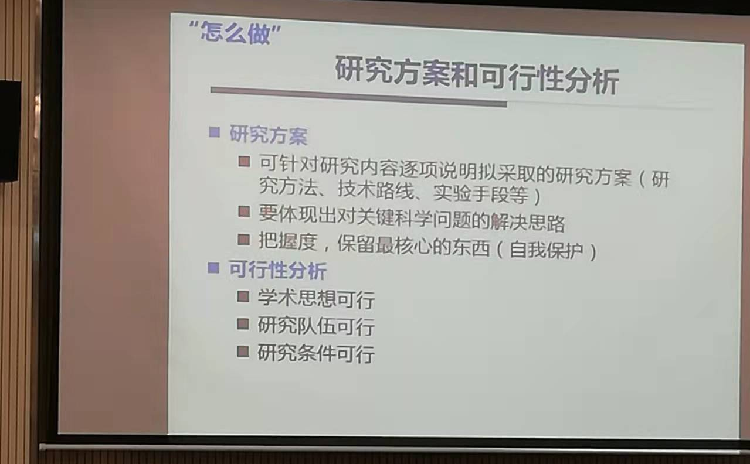
从项目申请看学生开题

Slide 34
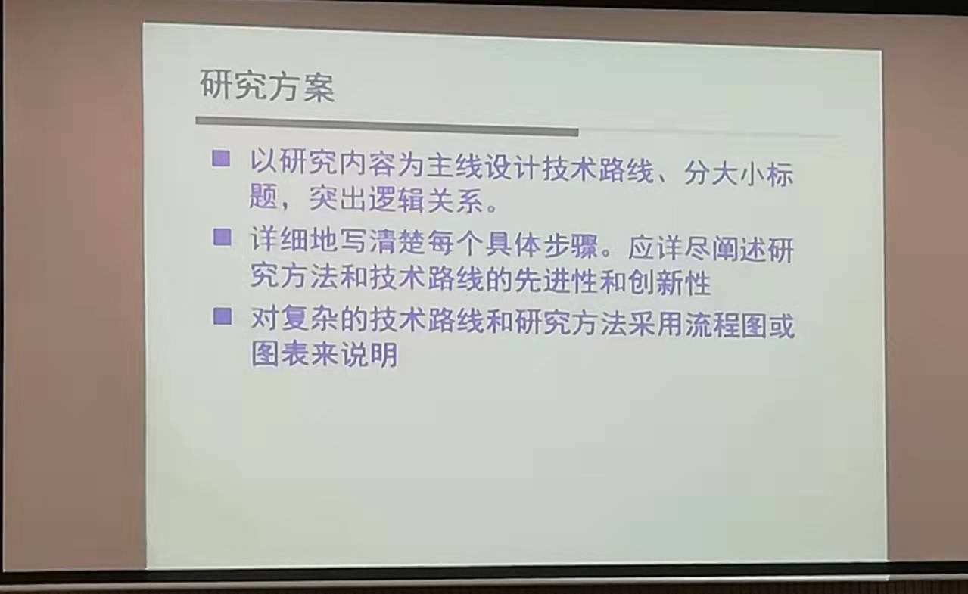
从项目申请看学生开题

Slide 35
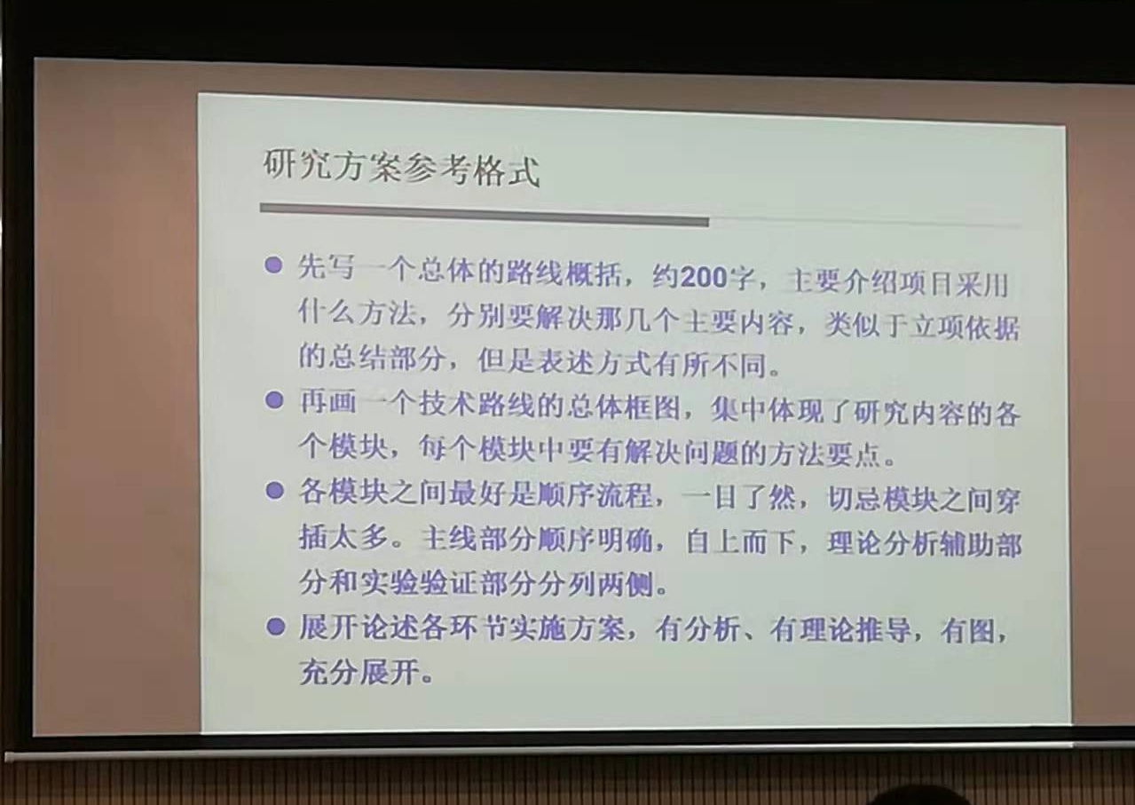
从项目申请看学生开题

Slide 36
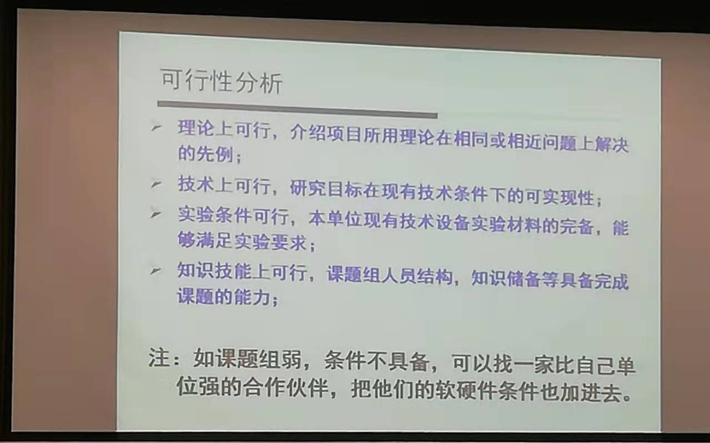
从项目申请看学生开题

Slide 37
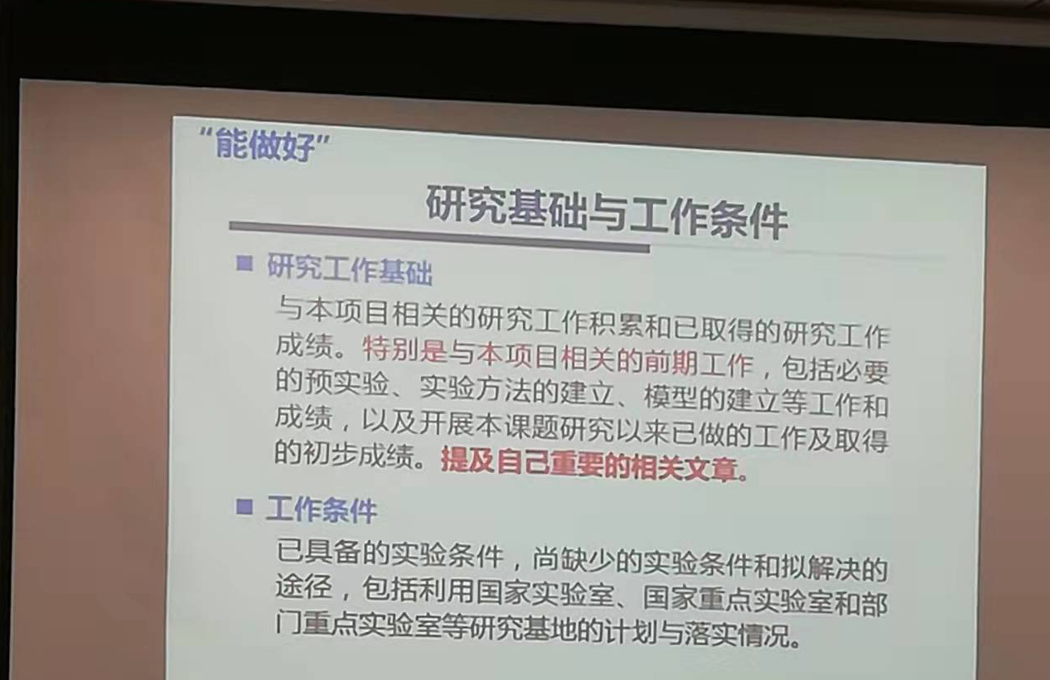
从项目申请看学生开题

Slide 38
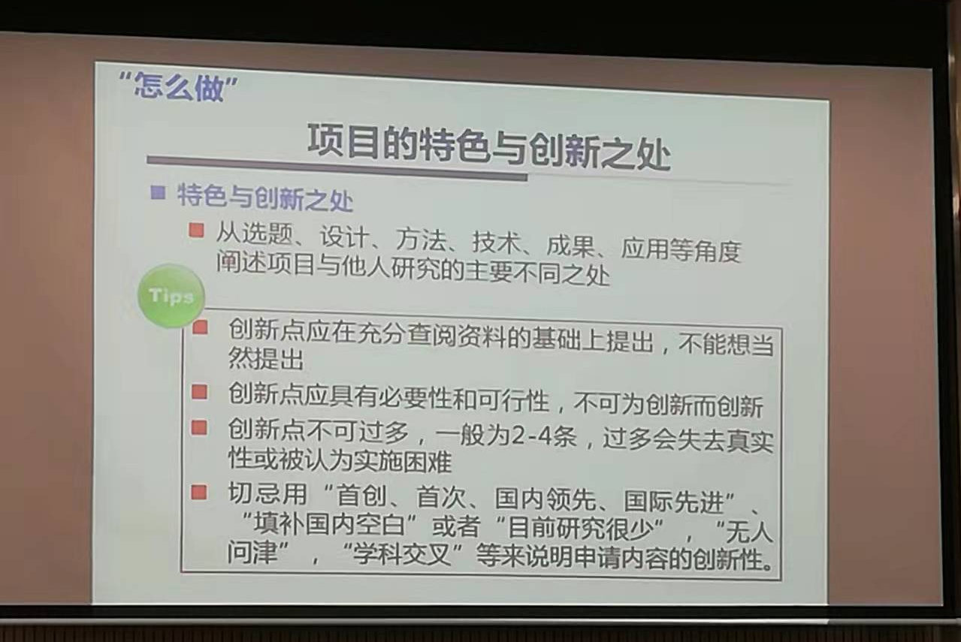
从项目申请看学生开题

Slide 39
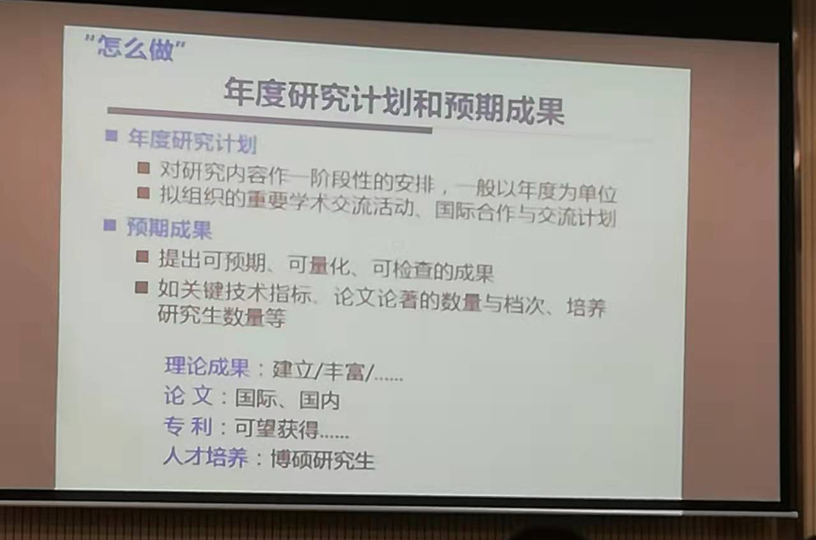
从项目申请看学生开题

Slide 40
10.3 Adjacency Matrices

Slide 41
10.4 Walk Relations

Slide 42
10.5 Directed Acyclic Graphs & Scheduling

Slide 43
10.6 Partial Orders

Slide 44
10.7 Representing Partial Orders by Set Containment

Slide 45
10.9 Product Orders

Slide 46
10.11 Summary of Relational Properties

Slide 47

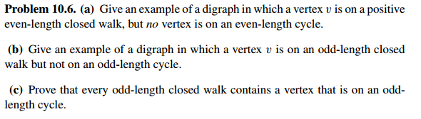
10.12 Group/Panel discussion
Group 1

